Slide 1
Check-up

Slide 2
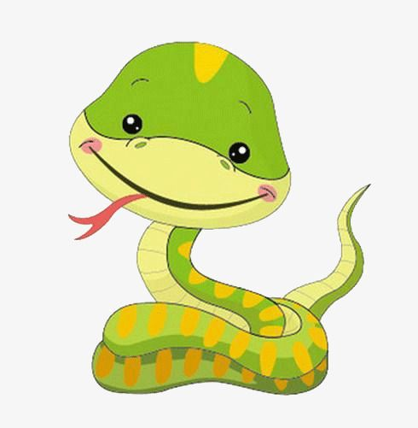
This is a …………….
A. Monkey
B. Snake
C. Bear

Slide 3
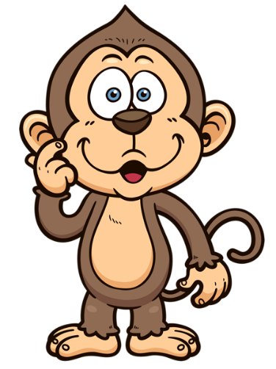
This is a …………….
A. Monkey
B. Snake
C. Bear

Slide 4
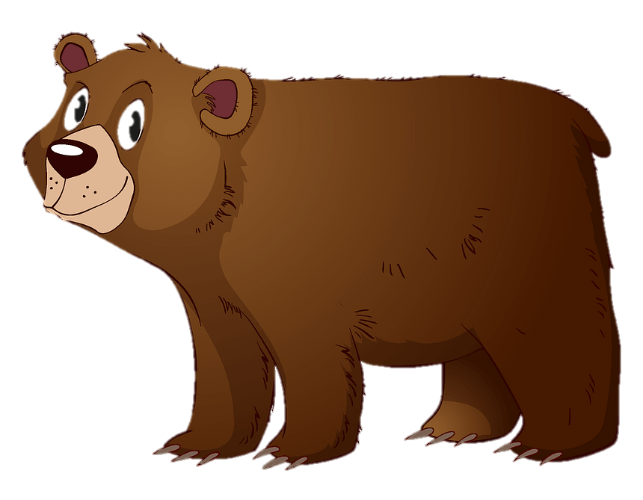
This is a …………….
A. Monkey
B. Bear
C. Snake

Slide 5
UNIT 5
ANIMALS
Lesson 3

Slide 6
Part D:
Listen to the story.

Slide 7
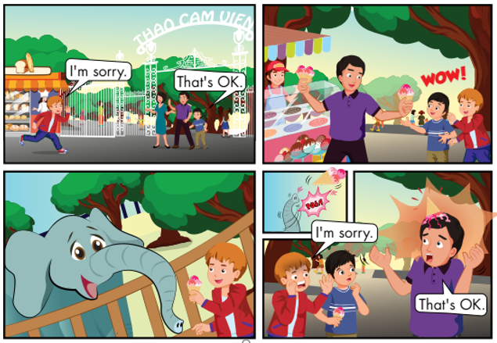

Slide 8
Part D:
Listen and repeat.

Slide 9
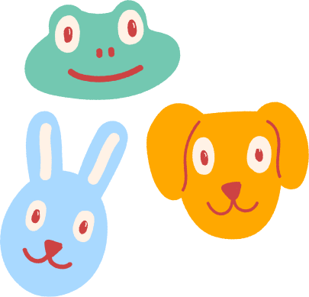
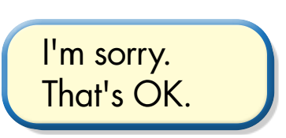
Structure
Cách nói xin lỗi và lời đáp lại.

Slide 10
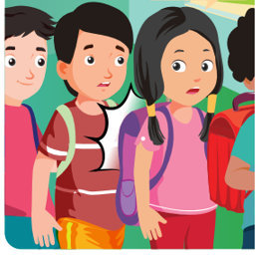
That’s OK.
I’m sorry !

Slide 11
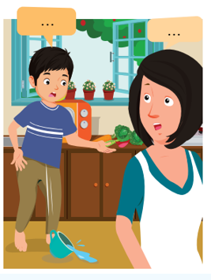
That’s OK.
I’m sorry !

Slide 12
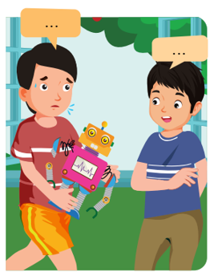
That’s OK.
I’m sorry !

Slide 14
Wheel of Fortune

Slide 15
Directions:
Divide class into 2 teams.
Take turn to play.
Click the Spin Button.
If it comes up a bomb, you’ll get 10 points minus.
- 10 points

Slide 16
STOP
8
7
2
3
5
4
SPIN

Slide 17
This is a bear.

Slide 18
STOP
8
7
2
3
5
4
SPIN

Slide 19
I like birds.

Slide 20
STOP
8
7
2
3
5
4
SPIN

Slide 21
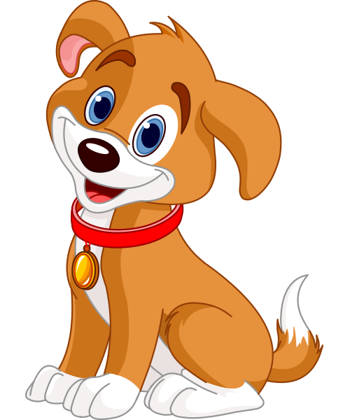
I like dogs.

Slide 22
STOP
8
7
2
3
5
4
SPIN

Slide 23
- 10 points

Slide 24
STOP
8
7
2
3
5
4
SPIN

Slide 25
This is a snake.

Slide 26
STOP
8
7
2
3
5
4
SPIN

Slide 27
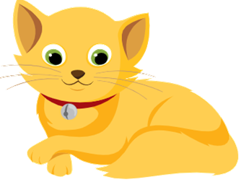
I like cats.

Slide 28
STOP
8
7
2
3
5
4
SPIN

Slide 29
This is a monkey.

Slide 30
STOP
8
7
2
3
5
4
SPIN

Slide 31
- 10 points

Slide 32
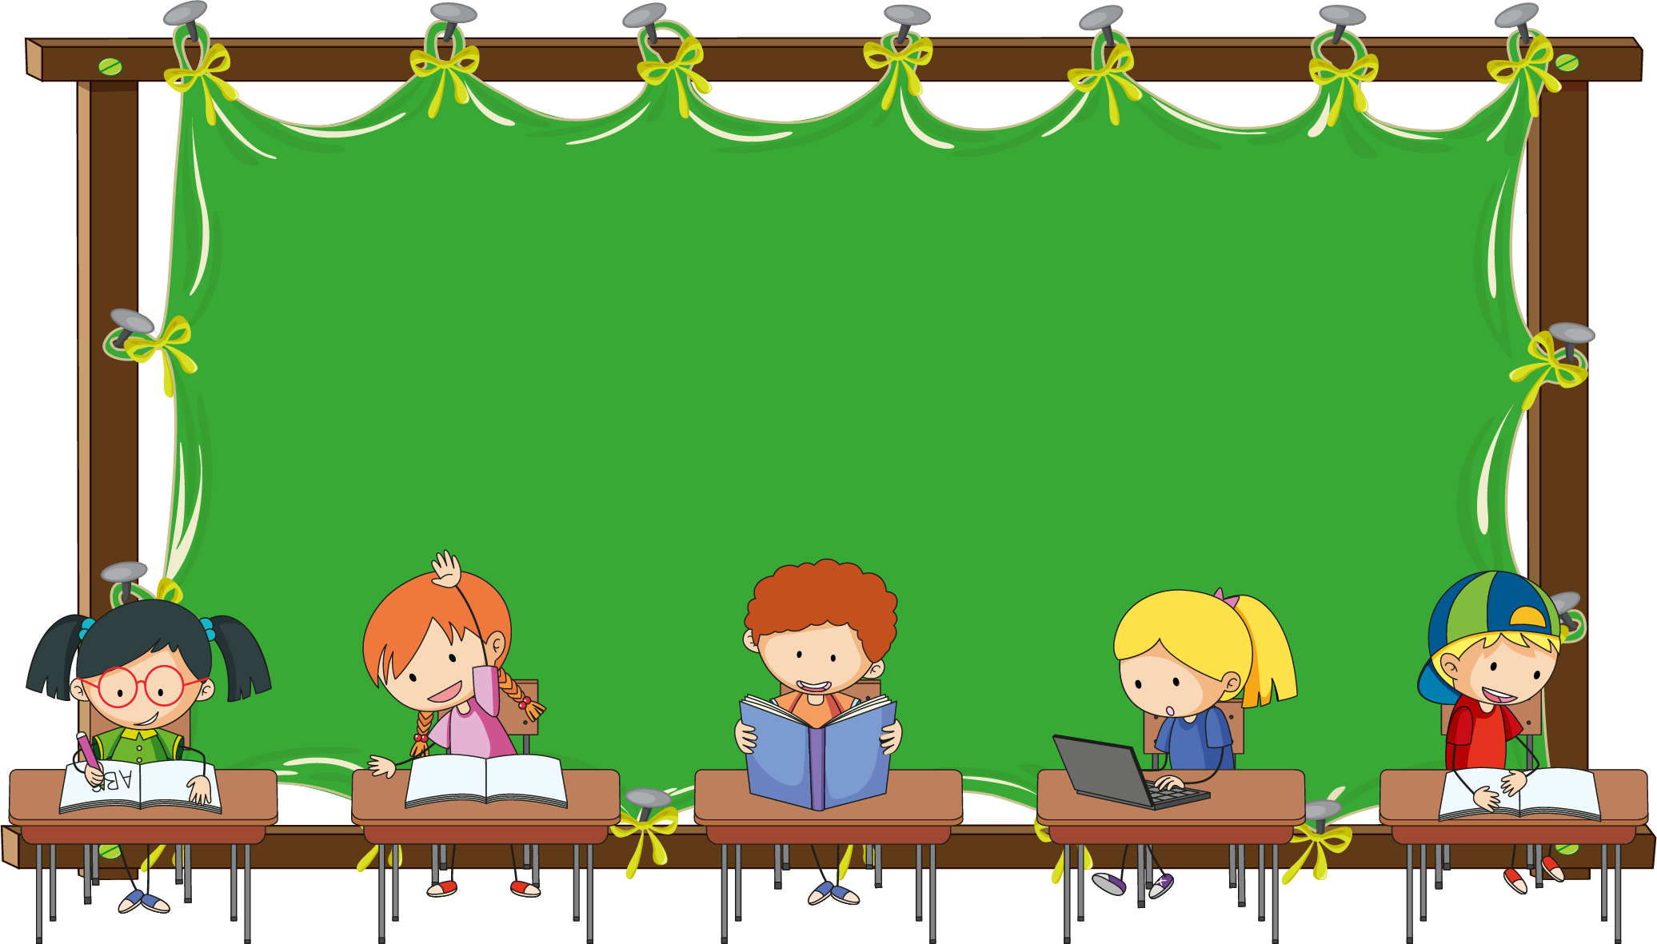
Thank you !

