Slide 1
CHECK-UP

Slide 2
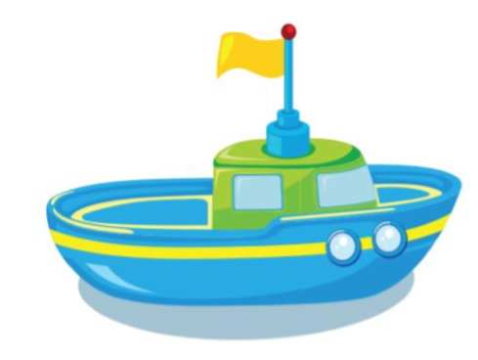
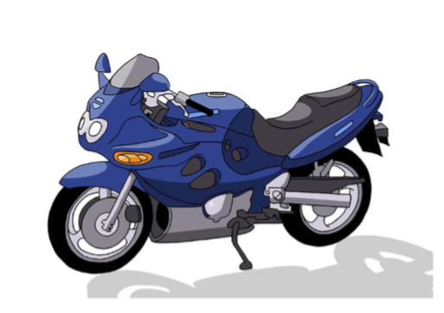
I see the photos
START

Slide 3
Rule
Click on the red button
and a photo will appear.
- Look at the photo and answer the question.

Slide 4
check
Can you see the car?
No, I can’t.
next

Slide 5
check
Can you see
the motorbike?
Yes, I can.
next

Slide 6
check
Can you see the plane?
Yes, I can.
next

Slide 7
check
Can you see the bus?
No, I can’t.
next

Slide 8
check
Can you see
the boat?
No, I can’t.
next

Slide 9
check
Can you see the bus?
Yes, I can.
next

Slide 10
Good job!

Slide 11
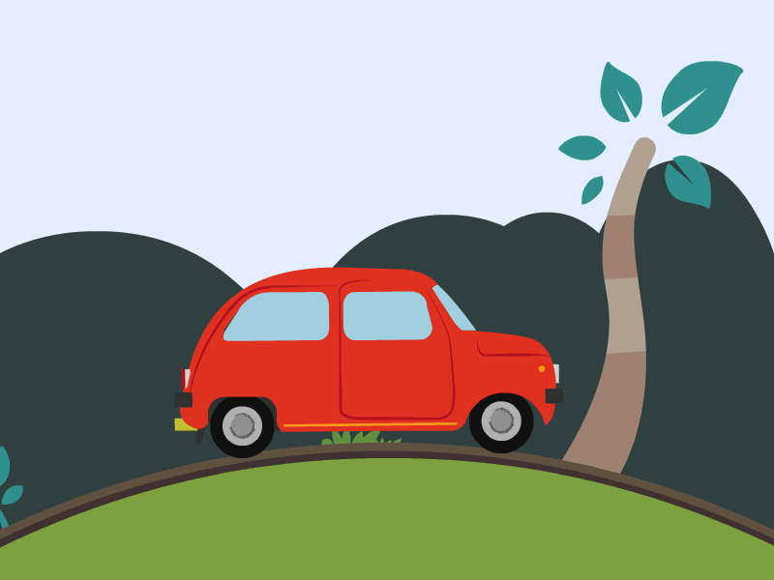
UNIT 8
TRANSPORTATION
Lesson 2

Slide 12
LETTER Xx
02

Slide 13
Introduction:
Letter X makes the sound x

Slide 14
How to write letter Xx?
X
x

Slide 15
Xx fox

Slide 16
Xx box

Slide 17
Part B:
Listen and repeat. Write.

Slide 18
x
x
x x fo__
x x bo__

Slide 19
Part C:
Sing.

Slide 20
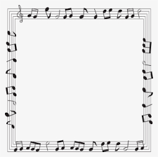
I can see a ,
x, x, .
I can see a ,
x, x, x.

Slide 22
LETTER Yy
03

Slide 23
Introduction:
Letter Y makes the sound y

Slide 24
How to write letter Yy?
Y
y

Slide 25
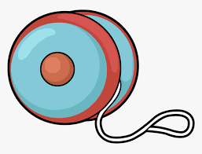
Yy yo-yo

Slide 26
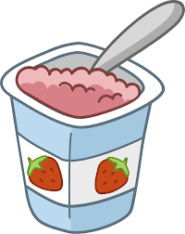
Yy yogurt

Slide 27
Part F:
Listen and repeat. Write.

Slide 28
y
y
y
y y __o-__o
y y __ogurt

Slide 29
Part G:
Sing.

Slide 30
I have a ,
y, y, .
I have a ,
y, y, y.

Slide 32
PLAY TIME

Slide 33
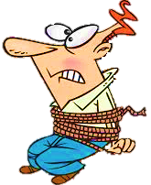

Slide 34
fox
box
NEXT
Listen and choose

Slide 35
fox
yo-yo
NEXT
Listen and choose

Slide 36
box
fox
NEXT
Listen and choose

Slide 37
yogurt
yo-yo
NEXT
Listen and choose

Slide 38
NEXT
Choose the picture of “box”

Slide 39
NEXT
Choose the picture of “yoghurt”

Slide 40
NEXT
Choose the picture of “fox”

Slide 41
NEXT
Choose the picture of “yo-yo”

Slide 42
“y”
”x”
NEXT
This word has the sound…

Slide 43
Click on the right option to save Peter
“y”
“x”
NEXT
What is the beginning sound?

Slide 44
“x”
“y”
NEXT
This word has the sound…

Slide 45
“x”
“y”
NEXT
What is the beginning sound?

Slide 46
Thank you

