Slide 1
Warm-up
“Wheels on the bus” action song

Slide 3
UNIT 8
TRANSPORTATION
Lesson 1

Slide 4
Part A:
Listen and point. Repeat.

Slide 5
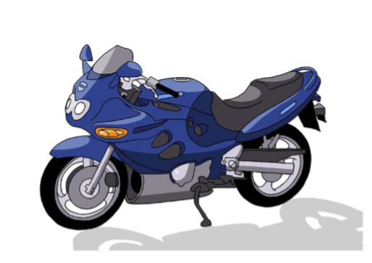
New words

Slide 6
Click on the picture to listen to the word.
bus

Slide 7
Click on the picture to listen to the word.
boat

Slide 8
Click on the picture to listen to the word.
plane

Slide 9
Click on the picture to listen to the word.
motorbike

Slide 10
Click on the picture to listen to the word.
bus
boat
plane
motorbike

Slide 11
CHECK YOUR MEMORY

Slide 12
motorbike
Click here to guess what vehicle behind.

Slide 13
bus
Click here to guess what vehicle behind.

Slide 14
boat
Click here to guess what vehicle behind.

Slide 15
plane
Click here to guess what vehicle behind.

Slide 16
Part B:
Listen to the story.

Slide 17
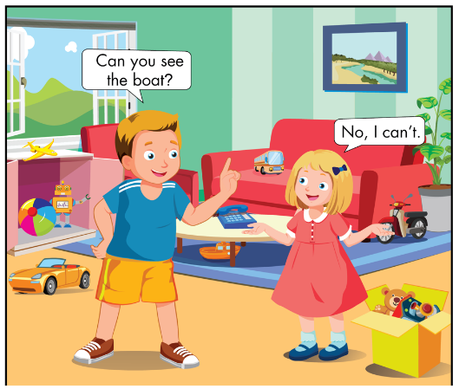

Slide 18
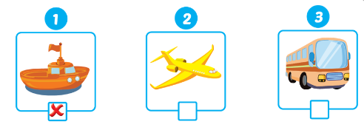
Listen and put a ( ) or ( ).

Slide 19
Part C
Sing

Slide 20
Can you see the bus?
Can you see the bus?
Yes, I can.
Yes, I can.
Can you see the plane?
Can you see the plane?
Yes, I can.
Yes, I can.
Can you see the boat?
Can you see the boat?
No, I can’t.
No, I can’t.
Can you see the motorbike?
Can you see the motorbike?
No, I can’t.
No, I can’t.

Slide 21
Structure:
Can you see the bus?
Bạn có thể nhìn thấy chiếc xe buýt không?
Yes, I can.
No, I can’t.
Note: can’t= can not

Slide 22
Part D
Ask and answer

Slide 23
Rule
Class will be divided into 2 teams: BOY and GIRL.
Take turn to play.
Each team has 5 seconds to look at the picture and answer the question.
If your answer is incorrect or time over, you will get NO POINT.
If your answer is correct, you’ll get 1 point/ star.

Slide 24
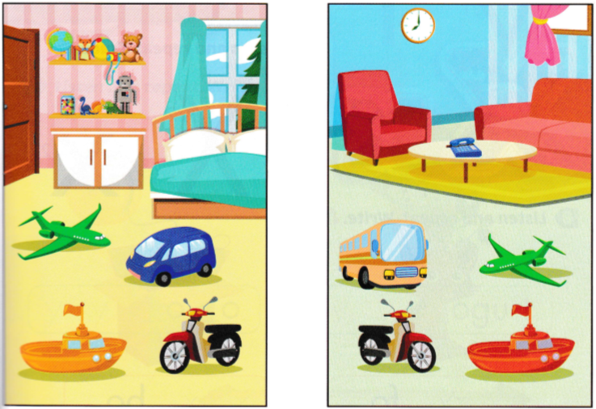
START TIMER
TIME LIMIT:
30 seconds
TIME’S UP!
Can you see the motorbike?

Slide 25
START TIMER
TIME LIMIT:
30 seconds
TIME’S UP!
Can you see the car?

Slide 26
START TIMER
TIME LIMIT:
30 seconds
TIME’S UP!
Can you see the bus?

Slide 27
START TIMER
TIME LIMIT:
30 seconds
TIME’S UP!
Can you see the boat?

Slide 28
START TIMER
TIME LIMIT:
30 seconds
TIME’S UP!
Can you see the plane?

Slide 29
START TIMER
TIME LIMIT:
30 seconds
TIME’S UP!
Can you see the bus?

Slide 30
START TIMER
TIME LIMIT:
30 seconds
TIME’S UP!
Can you see the car?

Slide 31
START TIMER
TIME LIMIT:
30 seconds
TIME’S UP!
Can you see the motorbike?

Slide 32
Time to play

Slide 33
Notes:
Thanh Yến Trần 0967 255 149 zalo/ FB https://www.facebook.com/thanhyentrananhngutaymy/

Slide 34
Can you see the motorbike?
ANSWER
Notes:
Thanh Yến Trần 0967 255 149 zalo/ FB https://www.facebook.com/thanhyentrananhngutaymy/

Slide 35
No, I can’t.
Notes:
Thanh Yến Trần 0967 255 149 zalo/ FB https://www.facebook.com/thanhyentrananhngutaymy/

Slide 36
Can you see the bus?
ANSWER
Notes:
Thanh Yến Trần 0967 255 149 zalo/ FB https://www.facebook.com/thanhyentrananhngutaymy/

Slide 37
No, I can’t.
Notes:
Thanh Yến Trần 0967 255 149 zalo/ FB https://www.facebook.com/thanhyentrananhngutaymy/

Slide 38
Can you see the boat?
ANSWER
Notes:
Thanh Yến Trần 0967 255 149 zalo/ FB https://www.facebook.com/thanhyentrananhngutaymy/

Slide 39
Yes, I can.
Notes:
Thanh Yến Trần 0967 255 149 zalo/ FB https://www.facebook.com/thanhyentrananhngutaymy/

Slide 40
Can you see the plane?
ANSWER
Notes:
Thanh Yến Trần 0967 255 149 zalo/ FB https://www.facebook.com/thanhyentrananhngutaymy/

Slide 41
No, I can’t.

Slide 42
Can you see the motorbike?
ANSWER

Slide 43
Yes, I can.

Slide 44
Can you see the plane?
ANSWER
Notes:
Thanh Yến Trần 0967 255 149 zalo/ FB https://www.facebook.com/thanhyentrananhngutaymy/

Slide 45
Yes, I can.
Notes:
Thanh Yến Trần 0967 255 149 zalo/ FB https://www.facebook.com/thanhyentrananhngutaymy/

Slide 46
GOODBYE!

