Slide 1
Monday, December 21st 2023
Warm up

Slide 2
1
1
ant
2
mouse
3
elephant
4
dog
5
fish
6
iguana
7
hen
8
pet
9
Notes:
Ms Huyền Phạm - 0936.082.789 – YOUTUBE: MsPham. Facebook: Dạy và học cùng công nghệ.

Slide 3
Question
1
2
3
4
5
6
7
8
9
10
Time’s up
on
When will the music festival be?
It’ll ___ Saturday.
Answer
Back
Notes:
Ms Huyền Phạm - 0936.082.789 – YOUTUBE: MsPham. Facebook: Dạy và học cùng công nghệ.

Slide 4
Question
1
2
3
4
5
6
7
8
9
10
Time’s up
will
When will the Children’s Day be?
It ___ on Saturday.
Answer
Back
Notes:
Ms Huyền Phạm - 0936.082.789 – YOUTUBE: MsPham. Facebook: Dạy và học cùng công nghệ.

Slide 5
Question
1
2
3
4
5
6
7
8
9
10
Time’s up
will
When ____ the Children’s Day be?
It will on Thursday.
Answer
Back
Notes:
Ms Huyền Phạm - 0936.082.789 – YOUTUBE: MsPham. Facebook: Dạy và học cùng công nghệ.

Slide 6
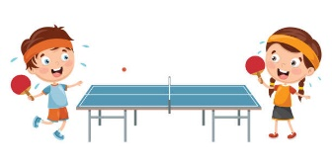
Question
1
2
3
4
5
6
7
8
9
What ____ going to do on Sports Day?
I’m going to play table tennis.
10
Time’s up
are you
Answer
Back
Notes:
Ms Huyền Phạm - 0936.082.789 – YOUTUBE: MsPham. Facebook: Dạy và học cùng công nghệ.

Slide 7
Question
1
2
3
4
5
6
7
8
9
What are you ____ ___ do on Teacher's Day?
We’re going to visit our teachers.
10
Time’s up
going to
Answer
Back
Notes:
Ms Huyền Phạm - 0936.082.789 – YOUTUBE: MsPham. Facebook: Dạy và học cùng công nghệ.

Slide 8
Question
1
2
3
4
5
6
7
8
9
What are you going to do ___ Children's Day?
10
Time’s up
on
Answer
Back
Notes:
Ms Huyền Phạm - 0936.082.789 – YOUTUBE: MsPham. Facebook: Dạy và học cùng công nghệ.

Slide 9
Question
1
2
3
4
5
6
7
8
9
10
Time’s up
I’m going to play badminton.
badminton./ play/ I'm/ to/ going/
Answer
Back
Notes:
Ms Huyền Phạm - 0936.082.789 – YOUTUBE: MsPham. Facebook: Dạy và học cùng công nghệ.

Slide 10
Question
1
2
3
4
5
6
7
8
9
10
Time’s up
going to
I’m _____ play football on Sports Day?
Answer
Back
Notes:
Ms Huyền Phạm - 0936.082.789 – YOUTUBE: MsPham. Facebook: Dạy và học cùng công nghệ.

Slide 11
Question
1
2
3
4
5
6
7
8
9
10
Time’s up
Quan and Nam are going to sing and dance on Children's Day.
Quan and Nam/ sing and dance/ Children's Day
Answer
Back
Notes:
Ms Huyền Phạm - 0936.082.789 – YOUTUBE: MsPham. Facebook: Dạy và học cùng công nghệ.

Slide 12
Unit 10
When will
Sports Day be?
Lesson 3

Slide 13
PRONUNCIATION

Slide 14
1. Listen and repeat.

Slide 15
2. Listen and underline the stressed words. Then say the sentences aloud.

Slide 16
PRACTISE

Slide 17
3. Let’s chant

Slide 18
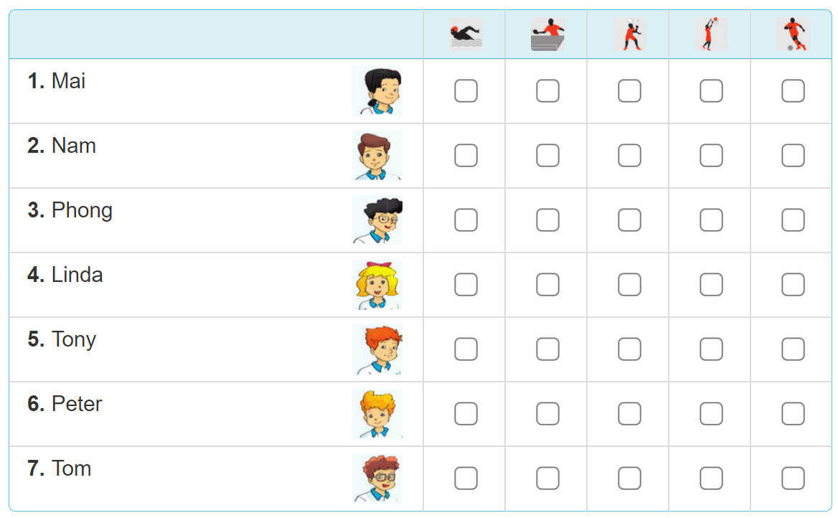
4. Read and tick

Slide 19
4. Read and tick
Our school Sports Day will be next Saturday. Everyone in my class is going to take part in it. Mai and Linda are going to play table tennis. Tony's going to play basketball and Peter's going to play badminton. Phong and Nam are going to play in a football match. Tom's going to swim. My classmates are practising hard for the events. We hope that we will win the competitions.

Slide 20
4. Read and tick

Slide 21
5. Write about Sport Day
Sports Day is going to be _______________.
Some of the boys are going to____________.
Some of the girls are going to_____________.
I am going to_____________________.
I hope that we will___________________.
on Saturday
play football
play badminton
play table tennis
win in the competitions

Slide 22
6. Project
Draw three sports and talk about them.

