Slide 1
Unit 10
When will
Sports Day be?
Lesson 2

Slide 2
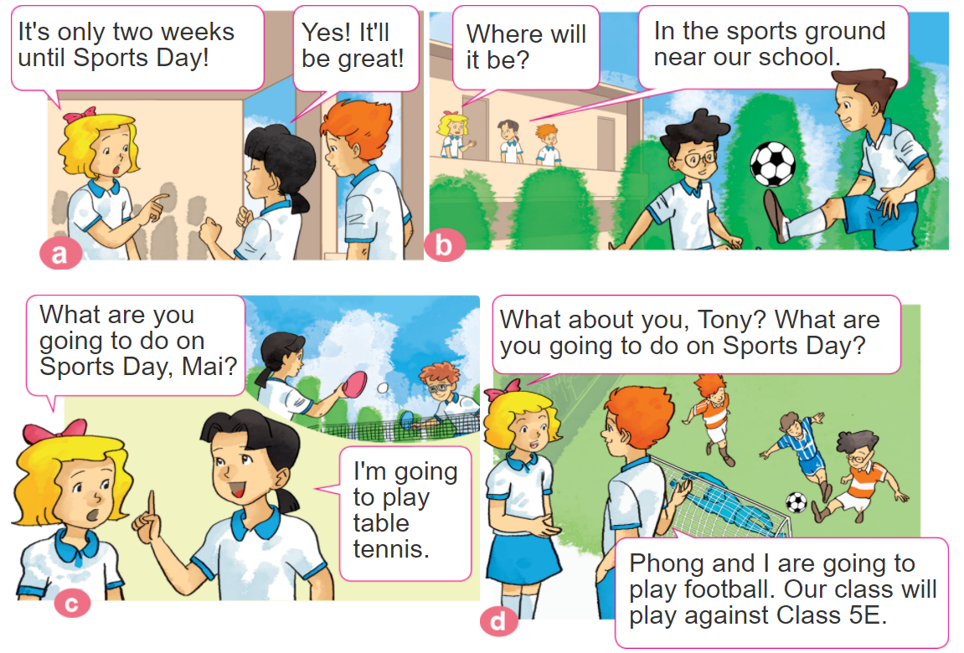
1. Look, listen and repeat.

Slide 3
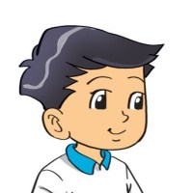
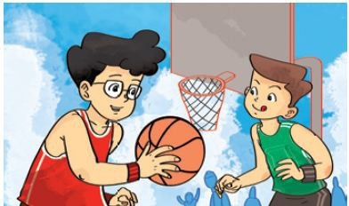
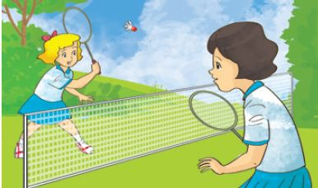
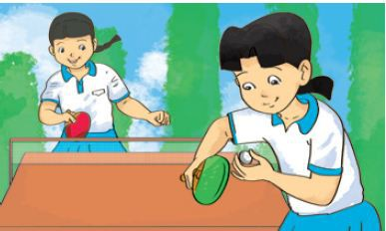
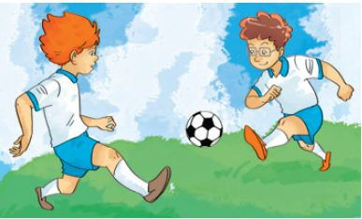
2. Point and say
What are you going to do on Sports Day?
I'm going to _________.
play
basketball
play badminton
play
table tennis
play
football

Slide 4
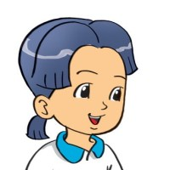
B. Grammar
Hỏi và đáp bạn sẽ làm gì:
(Bạn sẽ làm gì vào ngày hội thể thao?)
What are you going to do on Sports Day?
I'm going to _________.
+ hoạt động
(Tớ sẽ ______)

Slide 5
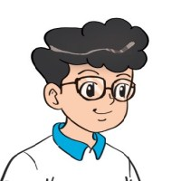
3. Let’s talk
When will Sports Day be?
It'll be on ________
What are you going to do?
I'm going to ______.

Slide 6
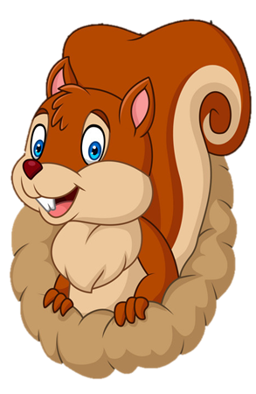
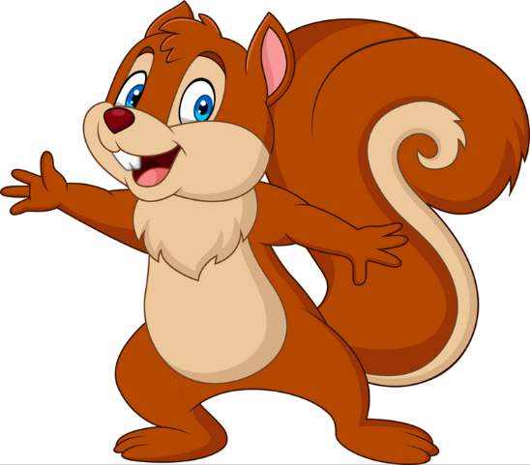
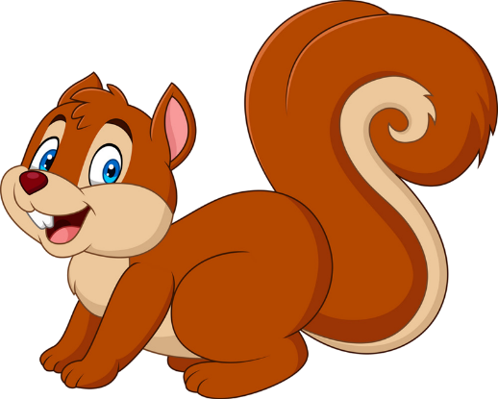
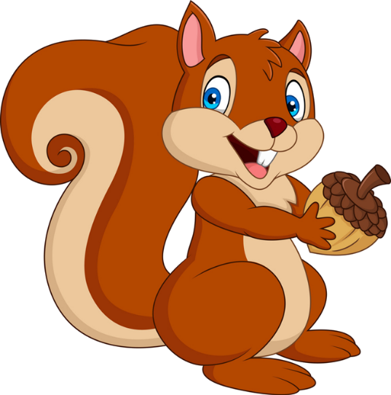
PLAY
NEXT
Brown squirrel
& acorn

Slide 7
What are you going to do on Sports Day?
I'm going to _________.
play badminton
Play basketball
farm
zoo

Slide 8
What are you going to do on Sports Day?
I'm going to _________.
play table tennis
play tennis
farm
zoo

Slide 9
What are you going to do on Sports Day?
I'm going to _________.
play basketball
play football
farm
farm

Slide 10
What are you going to do on Sports Day?
I'm going to _________.
play basketball
play baseball
farm
zoo

Slide 11
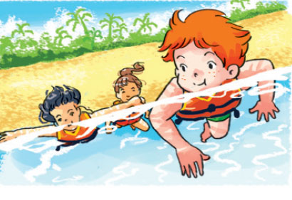
What are you going to do on Sports Day?
I'm going to ________.
go swimming
play basketball
farm
farm

Slide 12
What are you going to do on Sports Day?
I’m going to ................. table tennis.
playing
play
farm
farm

Slide 13
What are you going to .......... on Independence Day?
I’m going to sing in the singing contest.
do
be
farm
zoo

Slide 14
.......... will Sports Day be?
It’ll be on Friday.
Where
When
farm
farm

Slide 15
Good job!

Slide 16
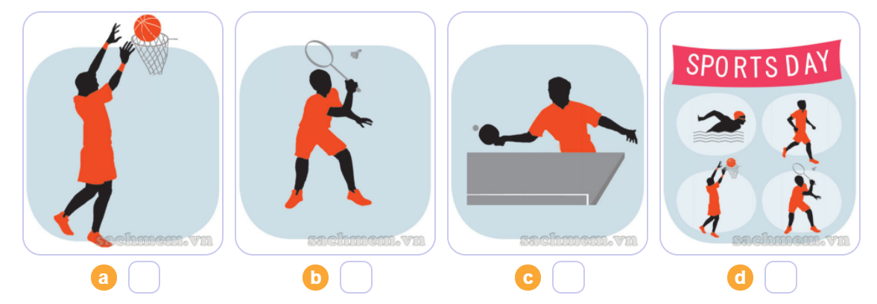
4. Listen and circle a or b.
4
2
3
1
1
2
3
4

Slide 17
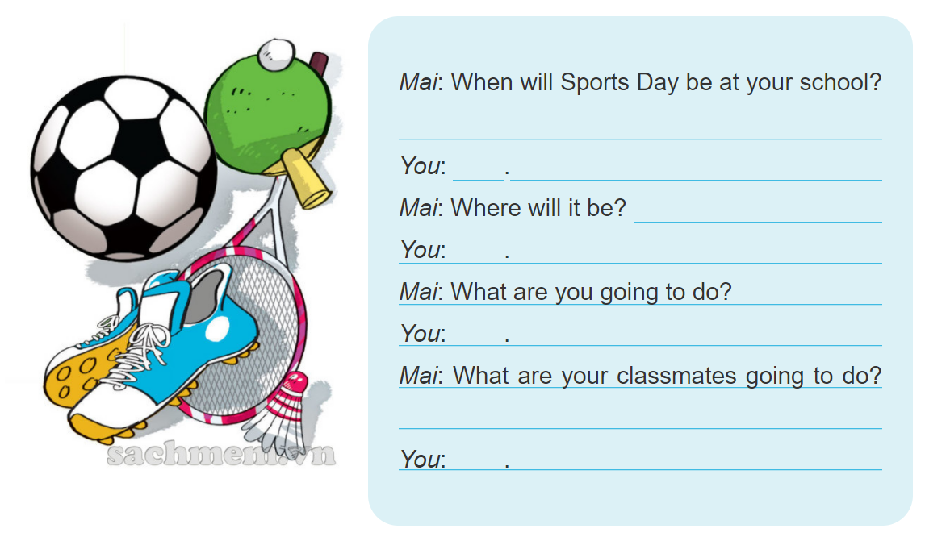
5. Write about you.

Slide 18
6. Let’s play

Slide 19
THANK YOU!
Welcome to join with me!
MsPham Powerpoint
Mspham

