Slide 1
Unit 7: clothes.

Slide 2
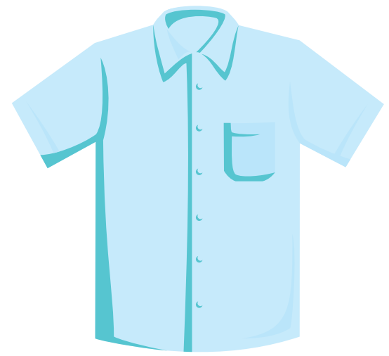
shirt

Slide 3
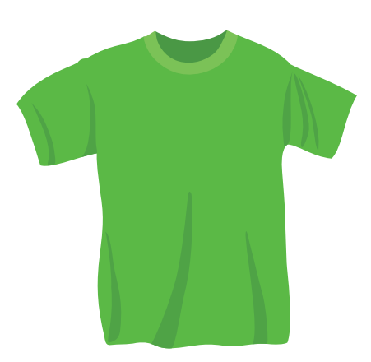
T-shirt

Slide 4
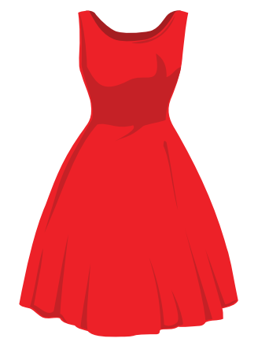
dress

Slide 5
shirt

Slide 6
Hat.

Slide 8
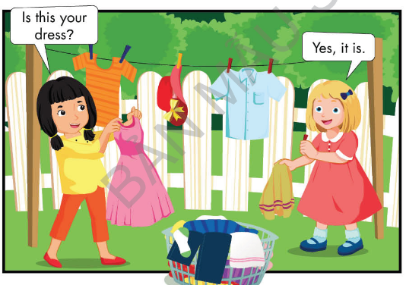

Slide 9
Model: Hỏi và trả lời “ Đây có phải áo sơ mi của bạn không?”
A: Is this your shirt?
B: Yes, it is
No, it isn’t

Slide 10
Yes, it is or No, it isn’t
Game

Slide 11
Is this your hat?
Great!
Yes, it is
No, it isn’t

Slide 12
Is this your T-shirt?
Great!
Yes, it is
No, it isn’t

Slide 13
Is this your shirt?
Great!
Yes, it is
No, it isn’t

Slide 14
Is this your T-shirt?
Great!
No, it isn’t.
Yes, it is

Slide 15
Is this your dress?
Great!
Yes, it is
No, it isn’t

Slide 16
Great Job!

Slide 17
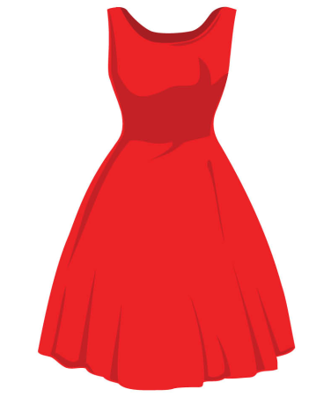
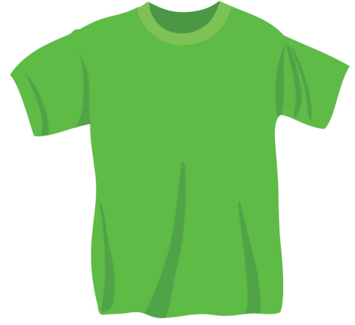
Listen and put a ( )or a ( ).
Touch the picture and see the correct answer.
1
2
3

Slide 18
Sing.

Slide 19
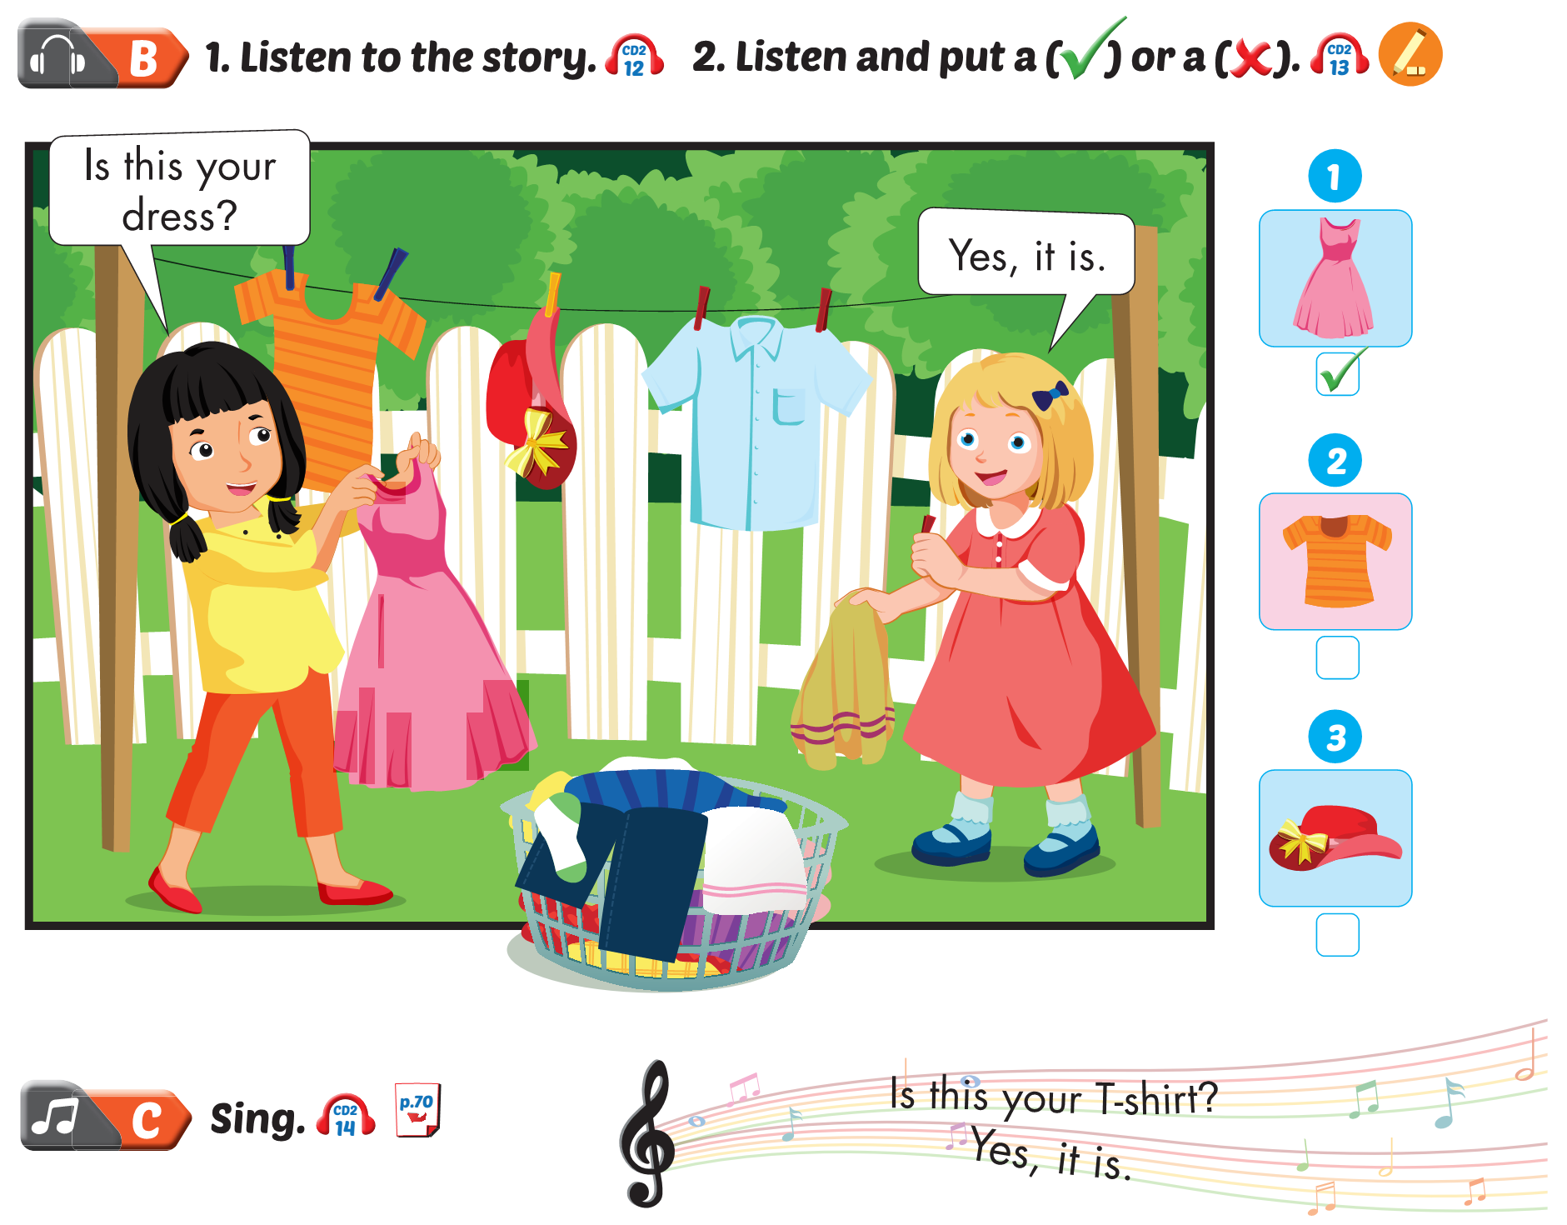
Lesson 1



Slide 20
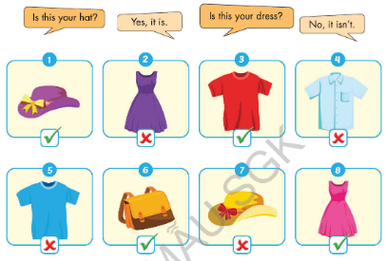

Slide 21
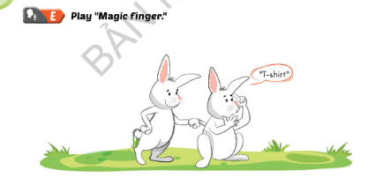

Slide 22
Friday, February 18^{th,} 2022 Unit 7: Clothes Lesson 1
1/ Voc:
- T- shirt: áo phông
- shirt: áo sơ mi
- dress: váy
- hat: mũ tai bèo
2/
Model: Hỏi và trả lời “ Đây có phải váy của bạn không?”
A: Is this your dress?
B: Yes, it is
No, it isn’t

Slide 24
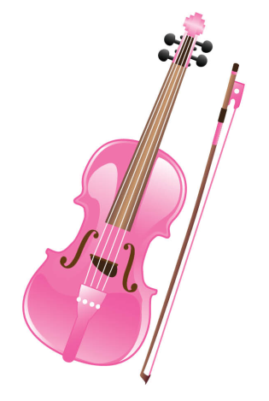
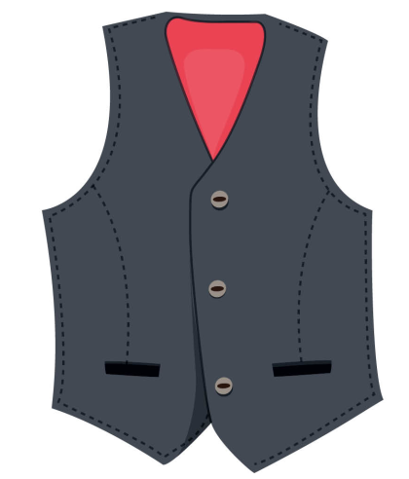
Listen and repeat. Write.
……iolin
……est

Slide 25
Sing.
I have a
V,v,
I have a
V,v,v.

Slide 26
Listen and jump.

Slide 27
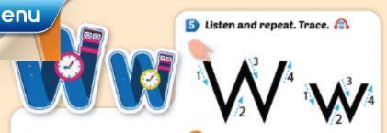

Slide 28
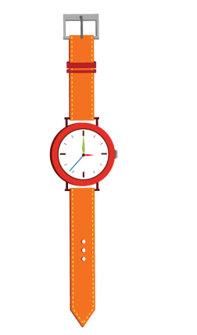
Listen and repeat. Write.
……atch
……indow

Slide 29
Sing.
It’s a
W, w.
It’s a
W, w, w.

Slide 30
Listen and clap.

Slide 31
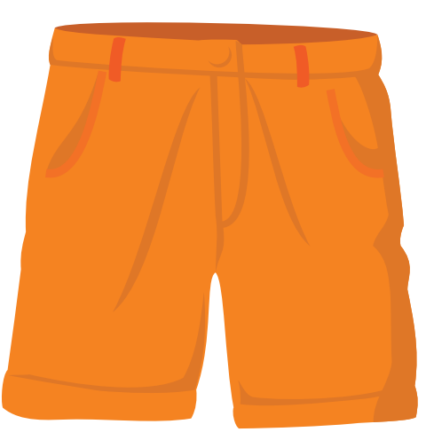
shorts

Slide 32
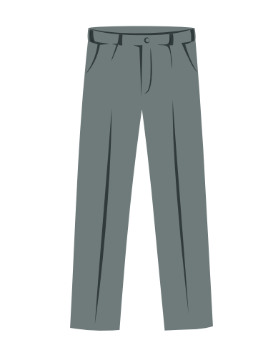
Pants

Slide 33
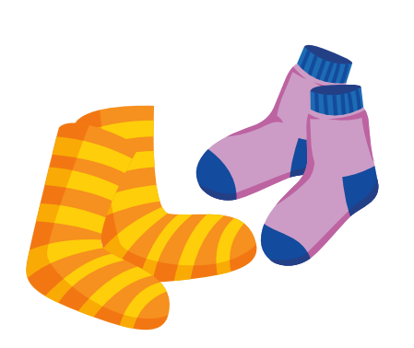
socks

Slide 34
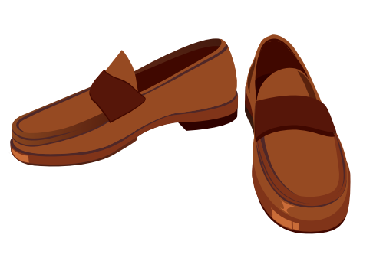
Shoes

Slide 36
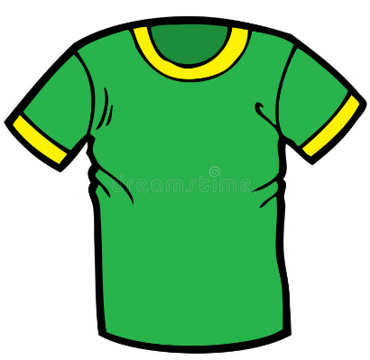
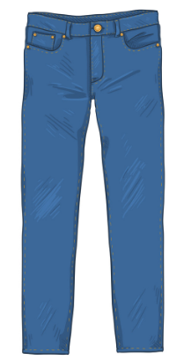
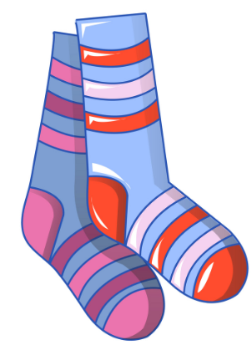
I want blue pants and greed T-shirt.

Slide 37
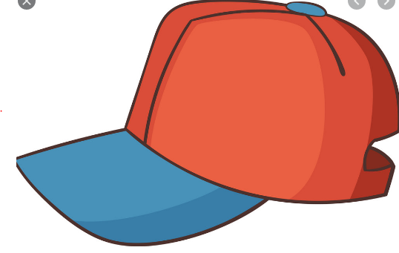
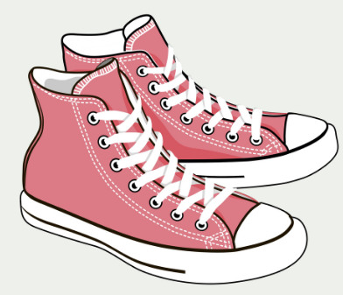
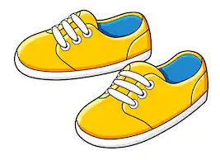
I want yellow shoes.

Slide 38
Draw lines. (Touch the picture and see correct answer).
T-shirt
Shoes
Cap

Slide 39
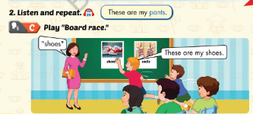

Slide 40
These is or These are
Game

Slide 41
There _____ a T-Shirt
Great!
is
are

Slide 42
These _____my pants.
Great!
is
are

Slide 43
These _____ my shoes.
Great!
are
is

Slide 44
These _____ my socks.
Great!
is
are

Slide 45
Great Job!

Slide 46
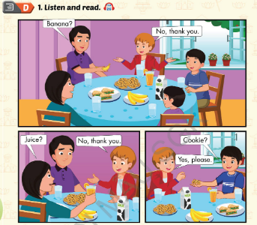

Slide 47
